Slide 1


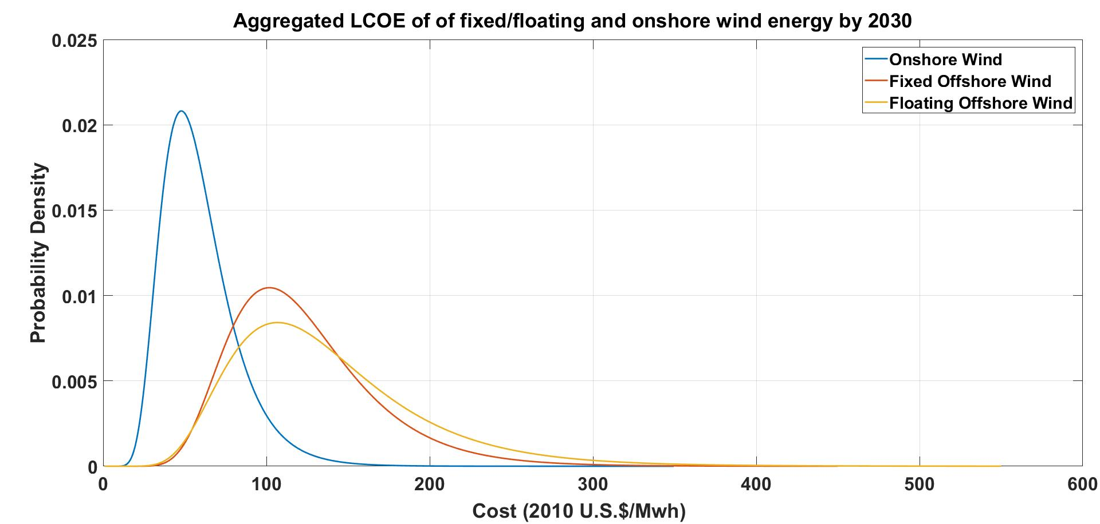
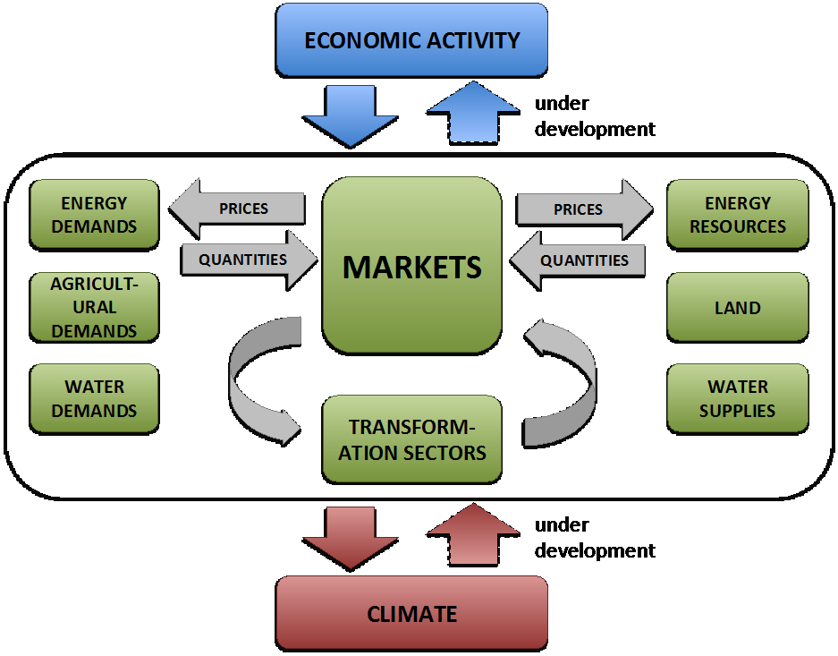
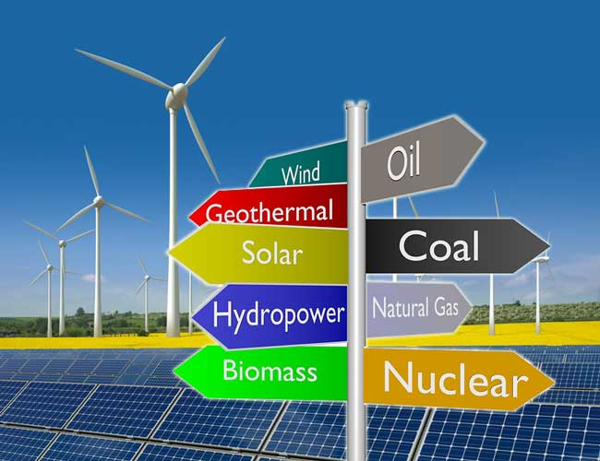
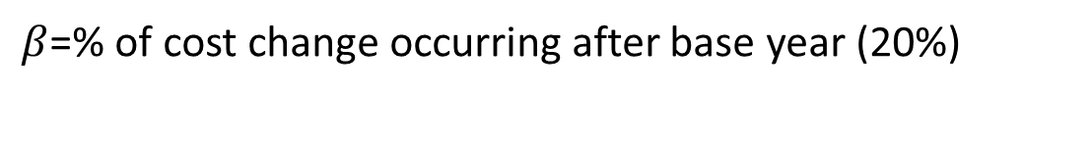
Implementing large-scale GCAM Simulations on a Super Computer
Ivan Norman, Franklyn Kanyako, Erin Baker
University of Massachusetts Amherst: Department of Mechanical and Industrial Engineering
Intro
Methodology
Results
Due to climate change many governments are discussing switching from High C02 emitting technologies to renewable technologies in an effort to reduce greenhouse gasses
We investigate how government-funded investments into research and development for renewable technologies might influence the cost of addressing climate change. To do this expert elicitations of the future cost of these technologies were investigated for their competitiveness against conventional technologies under various climate policies , using GCAM.
The objective of the project is to simulate GCAM 1000 times , for different samples, on the UMASS super computer and analyze the results
My primary role was developing a script that would prepare the inputs needed for GCAM to run 1000 times , and put all the results in one database
In this research we developed a Python script that would automate generating the GCAM Input files. The flow chart for the automation process can be seen in Figure 4.
An input file consists of multiple excel files which contain information regarding costs for the various energy technologies used in GCAM.
Each file listed in a GCAM input file depends on a specific cost input for that resource.
We also developed a batch script made to run on the UMASS load sharing facility (LSF) cluster. The batch script allowed GCAM to be solved 1000, in a time efficient manner. Using the batch script to perform parallel computing reduced the run time by a few weeks, when compared to the sequential approach.
To account for the changes in technology cost, each sample drawn from the distribution in Figure 2, represents the cost of wind in 2030 is passed through a learning rate using the equation below to create performance curves of the technology from 2015 to cost realization in 2030 and to the end of the century (2100), as seen in Figure 3 below. These performance curves are then converted into GCAM input.
The results of the GCAM simulations can be seen in Figure 5. This shows that with a high prediction for onshore wind costs (Figure 5 a) natural gas and coal are the primary suppliers of electricity, but with a low prediction for onshore wind (Figure 5 b) by 2080 onshore wind will be the primary supplier of energy. We also find that by 2030 onshore wind will be the second largest supplier of electricity.
$X_{t}=X_{2010}+{\frac{X_{2030−}X_{2010}}{1−β}\left(1−β\right)}^{\frac{t−2010}{2030−2010}}$
$β$=% of cost change occurring after base year (20%)
Background
(a) Onshore wind cost of electricity (2030) 20 cents/kWh
GCAM is an integrated assessment model that emulates the interactions between five systems: the energy system, water, agriculture and land use, the economy, and the climate.
One run of GCAM on a normal laptop takes upwards of an hour, with no policies.
Figure 2: Distribution Curve of Expert Predictions for offshore and onshore[1]
Draw electricity Cost of renewable technologies from a probability distribution
Onshore Wind
Offshore wind
Biomass
Solar
Nuclear
Carbon capture and storage
(b) Onshore wind cost of electricity (2030) 2 cents/kWh
Figure 5: Comparison of how a high (a) and low (b) prediction for onshore wind costs impacts electricity generation as a function of time for various technologies in GCAM
Conclusion
We were able to successfully run GCAM on the cluster, and currently we are implementing a method to complete 1000 simulations.
Theoretically, with parallel programming, 1000 runs would take around 1 hour to complete and combine results. In this project performing parallel computing led to significant time savings due to the original programming implementation taking 20 days for 1000 simulations.
For future improvements ,we plan to implement cloud storage to store our databases , since after one scenario GCAM produces results equaling 1-2GB. Additional future work includes combining the predictions from Figure 5 with the hundreds of other expert elicitations results to create a probability distribution for each technology
Pass that data through a Learning Rate.
Figure 1: Overview of how GCAM works[2]
Goals and Objectives
Convert data to Gcam CSV
The primary objective is to draw 1000 samples from the probability distribution curve of expert cost prediction and run those samples through GCAM to analyze the electricity generated by aggerate technology and primary energy consumption in different regions.
CSV to Gcam XML input
parallel Gcam simulation on Linux Cluster
Acknowledgements
Analyze outputs such as:
Electricity By aggregate technology
Primary energy consumption
CO2 Emission
GDP by region
The NSF-sponsored IGERT: Offshore Wind Energy Engineering, Environmental Science, and Policy (Grant Number 1068864)
Umass Armstrong Fund for Science
Umass Amherst College of Engineering
References
Figure 3: Learning rates for various technologies
Figure 4: Flow chart of the GCAM automation process
Franklyn Kanyako (Distribution curve graph)
The Joint Global Change Research Institute

